Slide 1
A note to students,
Many students are anxious about preparing a summer research presentation. They say, “but I haven’t done anything yet!.” Do not fear. We are all in the same boat. ☺
One of the learning goals of this presentation is to help you contextualize your research – that is, understand in what body of knowledge it is situated and how your work is going to contribute to that area. Preparing and giving a presentation about your work is an excellent way to learn about your area of inquiry.
As you plan and build your presentation, it forces you to think about the process you are undertaking – what will you have done at the end of these 8 weeks? And trust me – this will make you more aware of your field and the research area to which you are contributing. It will also provide you with a venue to practice the skills you will need to someday present scholarly work at a professional conference or meeting, to give an honors thesis defense or a job interview.
The slides that follow are recommendations and suggestions on how to organize your presentation. I am also happy to meet with you to discuss your individual presentation.
Best,
Dr. Colabroy (colabroy@muhlenberg.edu)

Slide 2
A Cool Title for my Presentation
See the “Notes” section under each slide in powerpoint for important information on the design and flow of this template presentation.
Blue text boxes contain my comments
By Joe Student
Advisor: Dr. Jill Professor
Date of Presentation
Location/Event (e.g Muhlenberg College Summer Research Seminar Series)
Notes:
As the title slide, this does not count toward your total slide number

Slide 3
This is my area of inquiry
(don’t make this your slide title – I’m giving you a generic outline)
Here is some background information on your area of inquiry that will provide your the audience with a framework for understanding the rest of this presentation
Tell the audience why they should care about this area of investigation. So what?
This slide is accessible everyone in the room – including student researchers from the sciences, the social science and the humanities
Relevant images make the slide visually appealing
References for content and images should appear at the bottom of the slide
Notes:
The slides to follow are a typical, generic way to organize a presentation. Not every presentation you see will be organized this way. Each discipline has its own preferences for how to deliver information in a presentation format. However, if this is your very first research presentation – a template like this can be a good place to start
When you give a talk about your research you are really telling a story – and every good story has an opening scene that gets us excited for what is coming next. Use this slide to get your audience excited! Show them why this area of inquiry is so important that you would dedicate your summer to it!
Presentations that contextualize the presenters work within an existing narrative are most easily understood by the diverse audience. You want to communicate your findings to the widest audience possible!

Slide 4
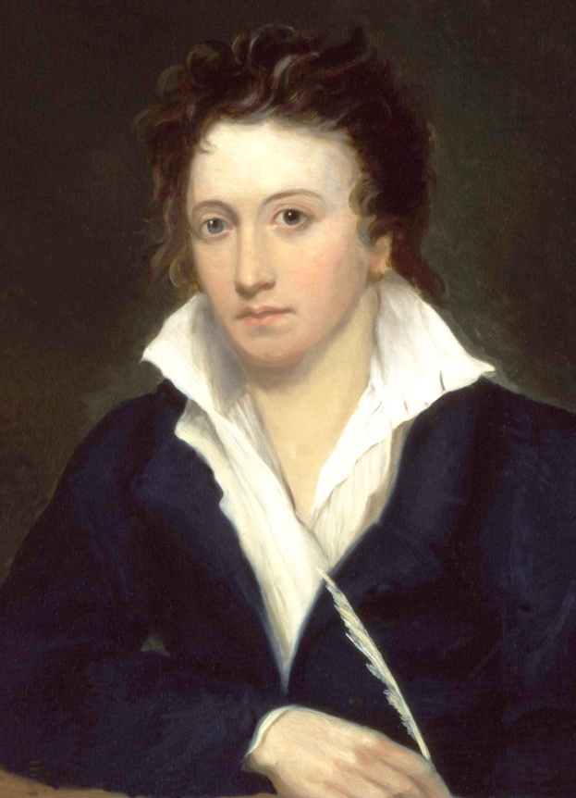
Frame your project
(don’t make this your slide title – I’m giving you a generic outline)
What are the interpretive frameworks, theories or historical narratives that provide a context for your research/investigation. Through what lens will you view this area of inquiry?
What previous work has been done in this area that is particularly relevant to your area of investigation or may have laid the groundwork for your particular project
Keep your audience in mind. It will contain people that are unfamiliar with your discipline.
References for content and images should appear at the bottom of the slide
Notes:
Balance the use of text and images throughout the presentation.
Use large font that is easily readable from a distance.
The image is of Percy Bysshe Shelley

Slide 5
The Problem/Question/Puzzle
(don’t make this your slide title – I’m giving you a generic outline)
See! There is a problem (or puzzle or unanswered question) right here
Now that you have established context, explain to the audience why there is a PROBLEM or QUESTION, something UNSOLVED or PUZZLING in this area of inquiry.
What is the nature of the puzzling observation, the sticky problem or the compelling question that you have chosen to spend your summer on? Show the audience what you need to figure out or develop an understanding of.
Use images to explain as much as you can – a presentation is visual. Use as little text as possible.
Notes:
Whether your research solves a problem or tries to answer a question will depend on the discipline you are performing research in. But at the most basic level, problems and questions are both things that puzzle us – something we want to figure out. Research is about figuring something out – no matter what discipline you are in.

Slide 6
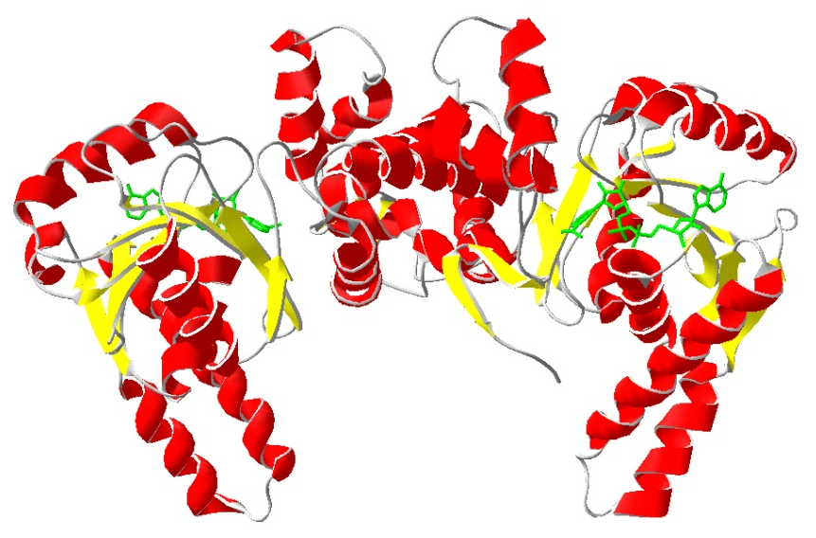
The Solution/Strategy/the BIG idea
Animation can be used to control the flow of information – see NOTES
Why should the audience believe your strategy will work?
  Have other people tried to solve this puzzle, or problem or answer this type of question before? Did they fail or fall-short for one reason or another? You should talk about their attempts (with references) here.
  How are you going to succeed where they have failed or pick-up where they left-off?
  Can you provide literature evidence (with reference) that backs up your ideas
SO WHAT? Why should we care…
Present the strategy for examining the PUZZLE, the PROBLEM or QUESTION that you have already outlined on previous slides.
Your strategy may be bigger than your research plan – it’s okay (even preferable) to dream big
There is a reference here because the image used was taken from another publication
Researcher, J Biochemistry (2000) 100 55
Notes:
Animation can be used to control the flow of information while preventing a slide from becoming too visually overwhelming. In PPT 2007, insert animation with the “Animations” tab. Don’t get too fancy – simple appearing and disappearing is fine. Jazzy animation can be distracting to your ultimate goal of delivering information. I always use the “Custom Animation” menu. If you click that option, you will see a toolbar appear on the right hand side of the powerpoint window showing the animation I have programmed onto this slide.

Slide 7
Your Research GOALS or TRAJECTORY how you are practically implementing your strategy
Keep your audience in mind. It will contain people that are unfamiliar with your discipline.
Goal #1/Step #1
  e.g. overexpress and purify X
  e.g. select a body of primary literature by Author Y
Goal #2/Step #1
  e.g. demonstrate activity for X
  e.g. evaluate the primary literature for evidence of theory Q
Goal #3/Step #3
  e.g. inhibit X with small molecules
  e.g. evaluate the primary literature for evidence of theory Z
Goal #4/Step #4
  e.g. investigate mechanism of the X reaction
  e.g. analyze the apparent opposition of theory Q and theory Z in Author Y’s writings
Notes:
Basically, your specific plan – how you’re going to implement your strategy to solve the problem or investigate the puzzling observation you have made.
Break your project into a series of goals you have achieved and perhaps some you may still be working on. OR break your project into a series of steps that you will progress through.
If we think about your project as a story – then the goals or steps are the fundamental plot elements that move the story forward. When discovering your plot elements, think about the ideal scenario for your summer of research. If everything worked out as you hope – what will you accomplish? Framing the future in this way helps the audience see the path you are going to take when tackling this project. Certainly, some of the goals/steps you will not have accomplished – and perhaps they still won’t be accomplished even after a whole summer. This is ok and normal.
This slide works really well as a bulleted list of goals or steps (perhaps with some description)– you will revisit this slide during your presentation to show your progress. Again, this is ONE way to organize a presentation. There are other ways. Talk with your research advisor before choosing a presentation template.

Slide 8
GOAL #1/STEP #1 – a Data/Observations slide
(again, do not make this your slide title – I’m giving you a generic outline)
What MATERIALS did you use to perform these observations or experiments?
What was the RESULT/OUTCOME What did you observe?
Show the DATA/EVIDENCE (a graph, a table, a figure, an image, some text…)
Interpret the DATA/EVIDENCE
Draw an IMPLICATION or a tentative CONCLUSION
Keep your audience in mind. It will contain people that are unfamiliar with your discipline.
This is important!
Notes:
This may take more than one slide. If your research produces quantitative data, this is one way you might represent such data. Some research produces narrative data, images or text that is not easily quantified. Such data could be represented with images (e.g. photos of newspaper articles, letters, artwork etc) or quotations from primary or secondary documents.
It is essential to make your data easy to interpret. The data should be the largest thing on the slide. Highlight important features. If your data ARE text – then highlight and color the text so the audience can follow your observations.
Scientific disciplines in particular are characterized by data, methods and nomenclature that are exclusive to each discipline. As you are presenting your data, you must be accurate, and you will likely need to use structures, diagrams and other images to make your point and that will be unfamiliar to a part of your audience. You should present your data as authentically as you can – but keep in mind, there are audience members that are desperately trying to follow your reasoning. Help them out. Be clear about the goal and the outcome of each experiment in the midst of all the science ☺ And don’t hide behind jargon.

Slide 9
Your Research GOALS or TRAJECTORY how you are practically implementing your strategy
Goal #1/Step #1
  e.g. overexpress and purify X
  e.g. select a body of primary literature by Author Y
Goal #2/Step #1
  e.g. demonstrate activity for X
  e.g. evaluate the primary literature for evidence of theory Q
Goal #3/Step #3
  e.g. inhibit X with small molecules
  e.g. evaluate the primary literature for evidence of theory Z
Goal #4/Step #4
  e.g. investigate mechanism of the X reaction
  e.g. analyze the apparent opposition of theory Q and theory Z in Author Y’s writings
See – you have accomplished Goal #1/step #1
Notes:
Basically, your specific plan – how you’re going to implement your strategy to solve the problem or investigate the puzzling observation you have made.
Break your project into a series of goals you have achieved and perhaps some you may still be working on. OR break your project into a series of steps that you will progress through.
If we think about your project as a story – then the goals or steps are the fundamental plot elements that move the story forward. When discovering your plot elements, think about the ideal scenario for your summer of research. If everything worked out as you hope – what will you accomplish? Framing the future in this way helps the audience see the path you are going to take when tackling this project. Certainly, some of the goals/steps you will not have accomplished – and perhaps they still won’t be accomplished even after a whole summer. This is ok and normal.
This slide works really well as a bulleted list of goals or steps (perhaps with some description)– you will revisit this slide during your presentation to show your progress.

Slide 10
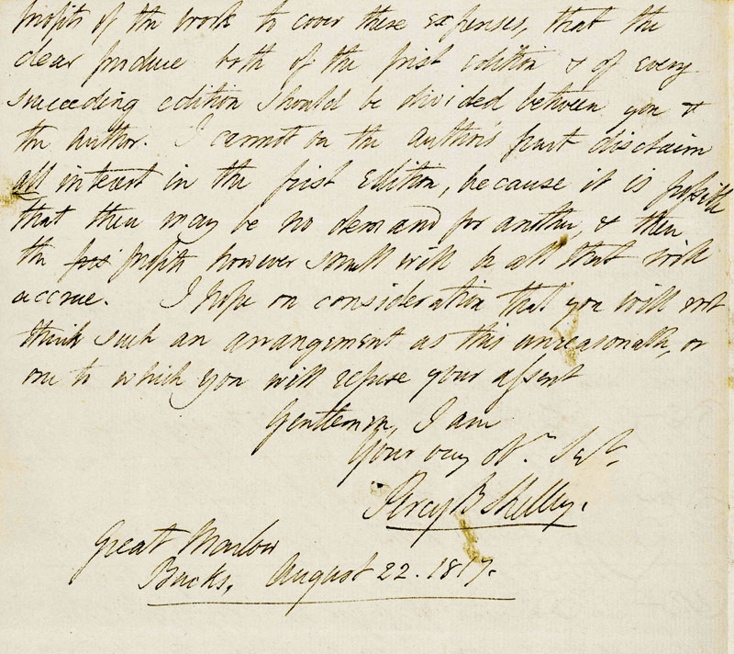
GOAL #2/STEP #2 – a Data/Observations slide
(again, do not make this your slide title – I’m giving you a generic outline)
Sometimes you are performing the same kind of analysis on multiple pieces of data or evidence. In this case, your slide can show a particular example of this analysis. By showing one example – you can give the audience some detail on what you did.
Materials?
Methods of analysis? (Theories, techniques)
Show the DATA/EVIDENCE, the primary source
Interpret the DATA or draw out implications from the EVIDENCE
Draw IMPLICATIONS or CONCLUSIONS
Image of an 1817 Percy Bysshe Shelley letter
This may take more than one slide
Notes:
If your research involves the analysis of text, then the PROCESS of analyzing that text can be a very significant part of the research. Adjust the information on each slide to represent accurately what your research accomplishes.
For example,
The method may be textual analysis of Shelley sentence structure and style in his personal letters for the purpose of comparing that style to his published work.
The “data” are the letters and published works – perhaps examples of the specific style could be articulated on the slide
The interpretation would be the style revealed by the textual analysis – patterns, anomalies etc
The conclusion is what the analysis tells you about the larger question (Is Shelley’s personal style reflected in his published works?)

Slide 11
Your Research GOALS or TRAJECTORY how you are practically implementing your strategy
Goal #1/Step #1
  e.g. overexpress and purify X
  e.g. select a body of primary literature by Author Y
Goal #2/Step #1
  e.g. demonstrate activity for X
  e.g. evaluate the primary literature for evidence of theory Q
Goal #3/Step #3
  e.g. inhibit X with small molecules
  e.g. evaluate the primary literature for evidence of theory Z
Goal #4/Step #4
  e.g. investigate mechanism of the X reaction
  e.g. analyze the apparent opposition of theory Q and theory Z in Author Y’s writings
See – you have accomplished Goal #2/Step #2
And so on…continue until you have covered your major goals or steps
Notes:
Basically, your specific plan – how you’re going to implement your strategy to solve the problem or investigate the puzzling observation you have made.
Break your project into a series of goals you have achieved and perhaps some you may still be working on. OR break your project into a series of steps that you will progress through.
If we think about your project as a story – then the goals or steps are the fundamental plot elements that move the story forward. When discovering your plot elements, think about the ideal scenario for your summer of research. If everything worked out as you hope – what will you accomplish? Framing the future in this way helps the audience see the path you are going to take when tackling this project. Certainly, some of the goals/steps you will not have accomplished – and perhaps they still won’t be accomplished even after a whole summer. This is ok and normal.
This slide works really well as a bulleted list of goals or steps (perhaps with some description)– you will revisit this slide during your presentation to show your progress.

Slide 12
Preliminary Conclusions
Review what you’ve observed, measured or found.
What might these observations, measurements or discoveries mean?
How does it impact the PUZZLE, the PROBLEM or the QUESTION you framed at the beginning?
Where do you go from here?
Have you kept your audience in mind? It will contain people that are unfamiliar with your discipline. Contextualize your findings for your audience.
Notes:
Remember how I said that your presentation is like telling a story? Well, every good story brings closure at the end. This is your slide for closure. Help the audience see how your work is making an impact on the exciting area of inquiry that you framed at the beginning of this talk.
To some extent, every research talk is a story about work-in-progress. There is always something else to learn, somewhere else to investigate or another lens to view these data through. This should not stop you from telling the very best story that you can at that moment in time.

Slide 13
Acknowledgements
It is normal to thank…
Your Advisor
Any on or off campus collaborators
The source of your funding (the Provost’s office, an NSF grant etc)
Anyone that helped you
Your audience (for listening to you)
Notes:
The acknowledgements slide does not count toward your total slide number.

Slide 14
Other info you should know…
Do you have abbreviations or acronyms in your presentation? Abbreviations and acronyms are frustrating to your audience. Use them sparingly and be sure to define them first.
When you use someone else’s ideas, figures, data etc – the citation for that information should appear right at the bottom of the slide.
Bullet your ideas (less text is better) and use images – figures, tables etc. It’s way easier to understand the trend in a numerical data set when its on a graph or in a table. Think VISUALLY.
Is there specialized jargon in your presentation? Please remember that the audience is diverse and may not be aware of jargon in your discipline.
Polished presenters practice their presentation. You should too.

Slide 15
These next slides are examples on how to organize images and deliver information in a presentation friendly and visually appealing way
When viewing these slides in PPT, look in the “Notes” section for information on how the slide is designed and organized.
These slides were created by Dr. Keri Colabroy using data from her research and by a graduate of the class of 2015. Do not share without permission.
Notes:
All these slides were created by Dr. Keri Colabroy using data from her research and by a graduate of the class of 2015. Do not share without permission.

Slide 16
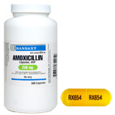
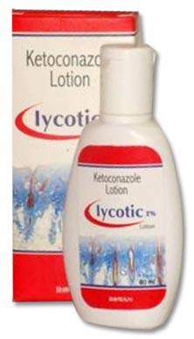

Natural products and human medicine
Antibacterial
Antifungal
Antitumor
Antiparasitic
Immunosuppressants
Cholesterol-lowering
Streptomyces in Nature and Medicine by D.A. Hopwood
Fishbach, Walsh and Clardy. PNAS March 25, 2008 vol. 105 no. 12 4601-4608
Notes:
This is an example of a background slide that I would use as an introduction.
Things to note:
I am saying a lot more than what is written here on the slide. The slide is not full of information, rather it has the main points: i.e. natural products are used in many areas of human medicine.
The goal is to balance the amount of information that is on the slide with what you are verbally going to communicate to the audience.
Notice the information I would be delivering on this slide has been referenced by two literature references at the bottom.
Notice the text is large (32 pt minimum, excluding references) and the slide is balanced with images and text.
The title is descriptive yet not too long.

Slide 17
Propylproline Biosynthesis
Step 1: Tyrosine Hydroxylase, LmbB2
Significantly more activity with peroxide as oxygen source
Roxanne Sholevar ‘11, Katherine Connor (UMD)
Notes:
Things to note:
The plot has been simplified to be as easy to read as possible:
Large data points in different shapes
Thick lines
No gridlines (they are too busy when viewed at a distance)
All plot labels are in large font and boldface so they are easily readable at a distance.
The use of animation (view the slide in “slideshow” to see the animation) introduces the featured information when the presenter is ready.
The key point in this dataset (the “blue” line) is highlighted by using a different color and by using animation to focus the audience’s attention on it at the right moment in the talk.
The slide has a title and subtitle
The title generally orients the reader to where this slide belongs in the presentation
The subtitle gives more specific information about this slide in particular
The work is referenced – in this instance, the student and collaborator that collected these data are indicated at the bottom of the slide. If you are the presenter and you personally collected the data, you do not need to reference yourself. Otherwise, reference whomever collected the data you are talking about.

Slide 18
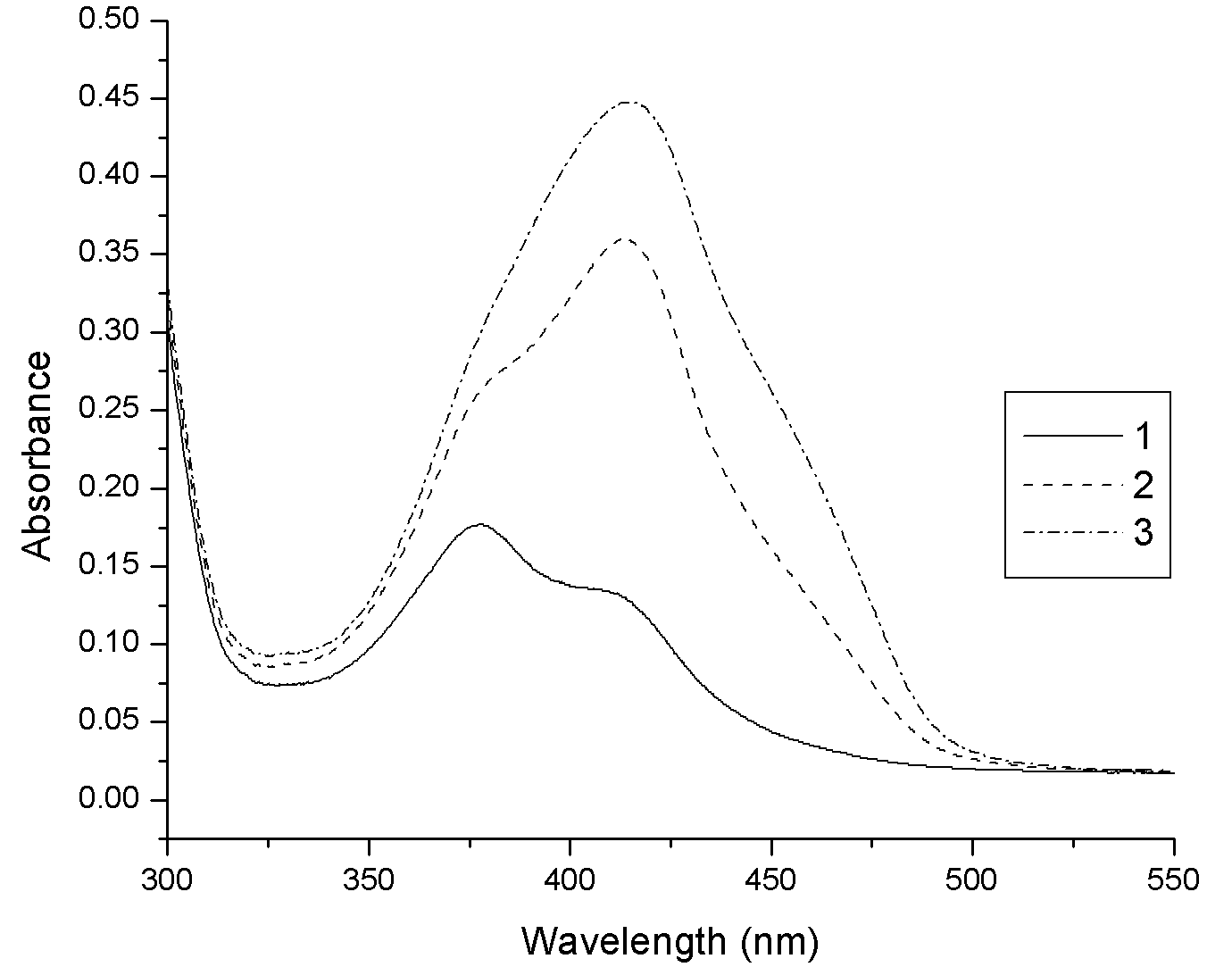
Propylproline Biosynthesis
Step 2: L-DOPA dioxygenase, LmbB1
The early moments of the LmbB1 reaction….
This is what we had been monitoring at 414nm
So what is this??
Additional pH and substrate analog studies indicated that the “linear “ form was the species at ~375nm
Billy Hackett ‘08
~414nm
Notes:
Notice how this slide uses animation to deliver one piece of information at a time and color to connect two sets of information (view in “slideshow” to see the animation).
The plot is done in black and white (with different lines) so that color can be used elsewhere to make a point.
The axes labels are boldface and as large as possible
All text is a minimum of 18pt size.
In this instance, the plot is describing a chemical reaction, so the structures are drawn on the slide and connected to the plot using colored boxes.
There are two, bright and contrasting colors used to make two different points. Use bright colors that can easily be viewed at a distance. Ensure lines are thick enough to be seen at a distance.
Text, structures and boxes are animated in one at a time. This allows the presenter to deliver one piece of information to the audience at a time. This give the presenter control of the information flow and prevents the slide from being visually overwhelming.

Slide 19
Reconstructing Eden:
Blake’s Composite Art
This is an example of a presentation from a humanities project.
Dr. Colabroy is using these slides with the knowledge and consent of the student author
Kelly Student
Advisor: Dr. Muhlenberg
Some date in the past
Muhlenberg College
Summer Research Seminar Series

Slide 20
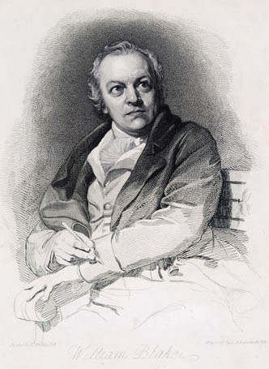
Background
This slide is demonstrating to the audience how Blake was trained as an artist. Blake is most well known for his writings – not his art. So this was important background information.
Blake was born on November 28th, 1757, in London
At age 10 he enrolled in Henry Par’s drawing school where he learned to draw the human figure from both plaster casts and classical statues. His art was influenced by Raphael, Romano, Michelangelo, Dürer, and Heemskerk.
He began an apprenticeship under James Basir at age fourteen and developed his skills as a copper plate engraver, the form that most of his art would take for the rest of his career.
He was a visionary artist in both the literal and figurative sense—Blake saw visions of angels and spirits his entire life, which greatly impacted his art and poetry.
This slide is a little text heavy. Some of this text could have been summarized with key words or replaced with images. The presenter would have then spoken this information instead of “reading” it off the slide.
Notes:
This slide is demonstrating to the audience how Blake was trained as an artist. Blake is most well known for his writings – not his art. So this was important background information.
This slide is a little text heavy. Some of this text could have been summarized with key words or replaced with images. The presenter would have then spoken this information instead of “reading” it off the slide.

Slide 21
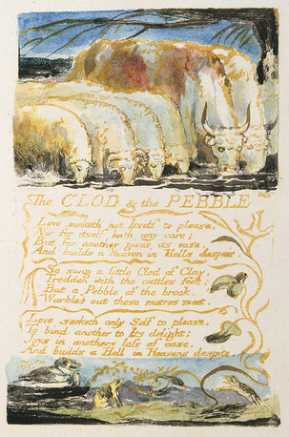
Fluency in Two Languages—
Goals and Objectives
Blake was interested in the potential for art and language to interact with and enhance one another. In Blake’s work, the visual and textual narratives he constructs are never without reference to one another, creating an art that can only be referred to as “composite”
The chronology of Blake’s work shows a increasing interest in collapsing the binaries erected between the visual and the verbal in his earlier works, changing the nature of how text and image interact with one another.
The amount of text on this slide is a bit overwhelming for the audience. Some of this text could have been summarized with key words or replaced with images. The presenter would have then spoken this information instead of “reading” it off the slide.
The author of this presentation is showing us the interesting observation that inspired her work – mainly that Blake creates visual art and words as part of his literary works, and that over time – his art and his words get more and more intertwined. This is what she is excited about!
Notes:
The author of this presentation is showing us ther interesting observation that inspired her work – mainly that Blake creates visual art and words as part of his literary works, and that over time – his art and his words get more and more intertwined.
The amount of text on this slide is a bit overwhelming for the audience. Some of this text could have been summarized with key words or replaced with images. The presenter would have then spoken this information instead of “reading” it off the slide.

Slide 22
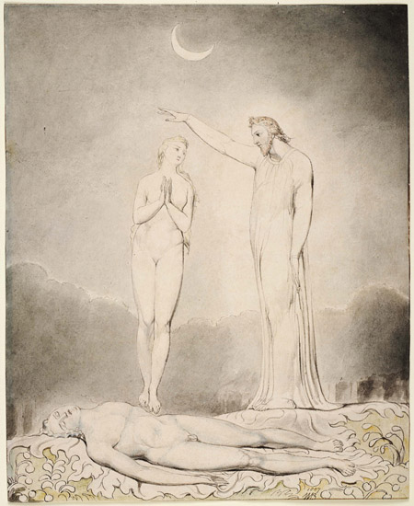
Objectives
The student has framed her research trajectory with “objectives”. She will analyze both text and images looking for repetition and patterns – with a hope of understanding the “composite art” (the images and words intertwined). She is helping us (the audience) understand the “the puzzle” she has found.
My main goal with this project is to study the chronology of Blake’s work by analyzing both text and image, looking for repetitions and patterns in order to come to a conclusion about the nature of Blake’s composite art.
I plan to continue to pursue this research through the school year, culminating in a senior honors thesis for my English major
The Creation of Eve
Illustrations to Milton’s “Paradise Lost”
1807
Notes:
The student has framed her research trajectory with “objectives”. She will analyze both text and images looking for repetition and patterns – with a hope of understanding the “composite art” (the images and words intertwined). She is helping us (the audience) understand the “the puzzle” she has found.

Slide 23

Opposing States of Being
My interest in this aspect of Blake’s work lies in how he may be using this composite art as a visual and linguistic allegory for the Fall of Man—using visual and textual narratives in order to explore Edenic and Post-Edenic spaces in art.
The student has provided two goals for her research. This is what she will work toward all summer and into the next academic year.
Through my research of both Blake’s visual and textual narratives I hope to uncover:
how these narrative forms are being used to collapse and reconcile opposing states of being—not only visually and linguistically but their larger implications
what this means in terms of Blake’s ideologies surrounding religion, philosophy, and the nature of humankind. Can Eden be reconstructed, if only through art?
Title Page
Songs of Innocence and of Experience
1789, 1794
Notes:
Notice how the student has titled this image. All images should be referenced.

Slide 24
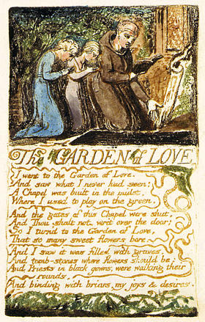
During her presentation, this slide and the 5 that follow were the raw “data” of the presentation. She demonstrated how the relationship between art and text in each work. Explaining her observations and how they were impacting her understanding.
Notice how the image is of high quality and easily viewed at a distance.
The Garden of Love
Songs of Innocence and of Experience
1789

Slide 25
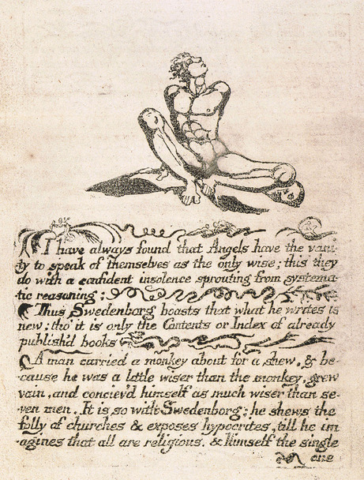
Plate 1
The Marriage of Heaven and Hell
1790

Slide 26
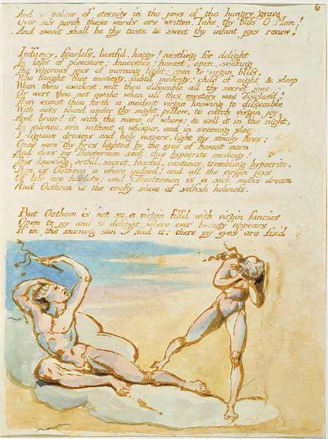
Plate 6
Visions of the Daughters of Albion
1793

Slide 27
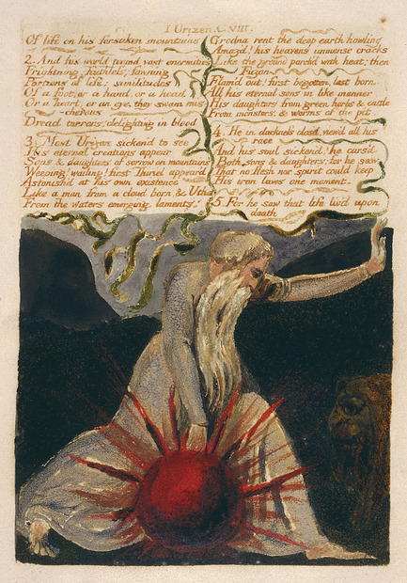
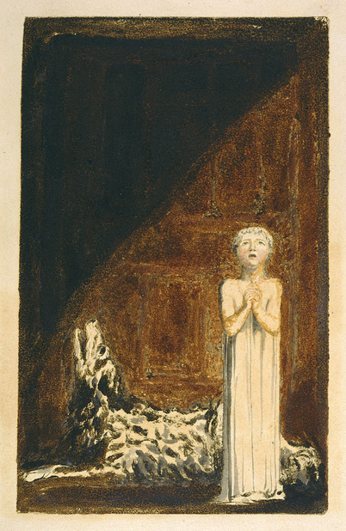
Plate 25
The First Book of Urizen
1794
Plate 26
The First Book of Urizen
1794

Slide 28
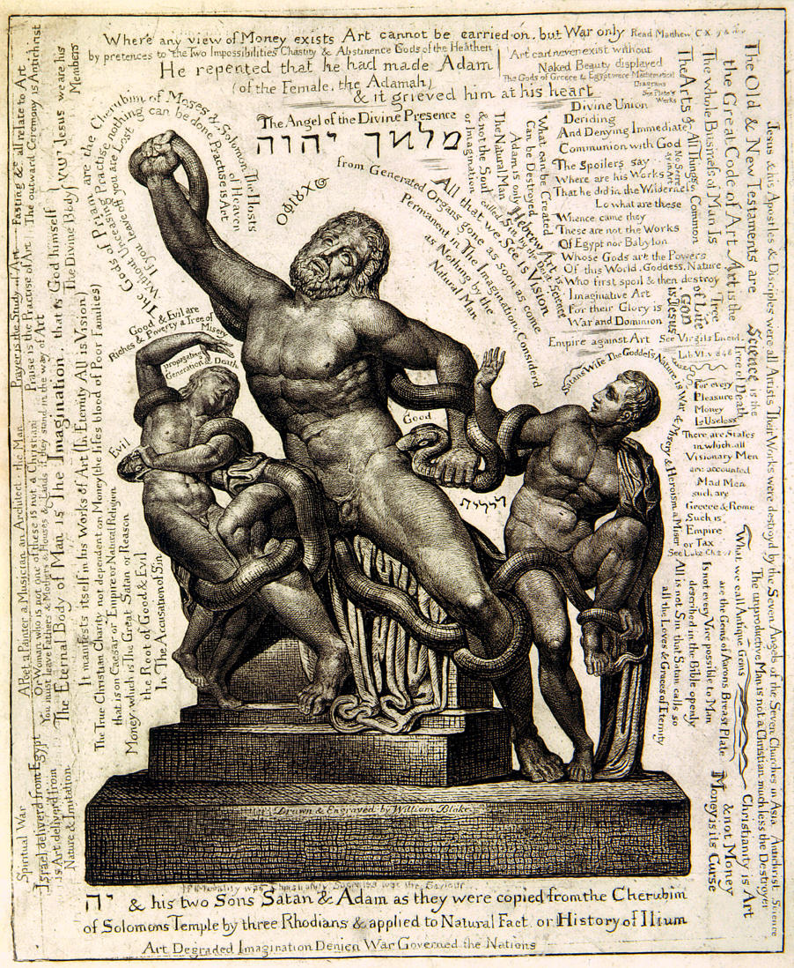
Lacoön
1826-7

Slide 29

This is the final content slide of this student’s presentation. Her project was still in progress at that time. I would recommend the addition of a “preliminary conclusions” slide to provide some closure to the presentation.
The Fall of Satan
Illustrations of the Book of Job
1826

